Slide 1

The Interaction between Groundwater and Surface water
The Concept Instrumentation and Application to Eastern Ontario
Based on a Regional Study of the Rideau Valley Watershed
Presented to the IAH GeoMontreal Conference
September 30, 2013
Mezmure Haile-Meskale, Ph.D., P.Geo

Slide 2
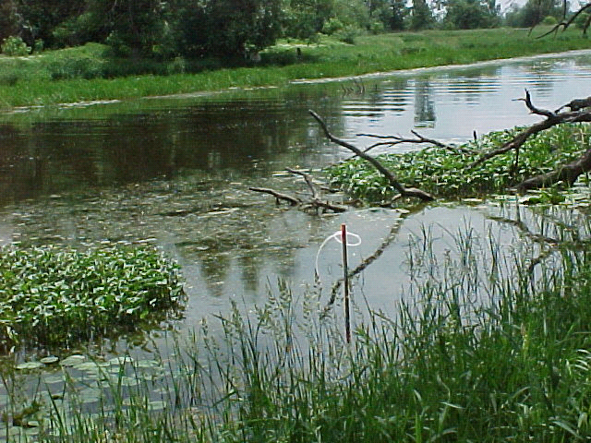
Presentation Topics
(simple methods)
  The concept and the need to study GW/SW interactions
  Various ways of measuring seepages under different physiographic conditions
  Interpretation of the field results and conclusions
Purpose of this Presentation
to reflect upon:-
  the interconnectivity of different factors, such as climate, physiography, soil, vegetation etc. within a watershed
  the spatial (surface – near surface) and temporal variations in the interaction between GW/SW
consider the result from such studies, depending upon the case,
to other groundwater studies involving deeper water wells

Slide 3
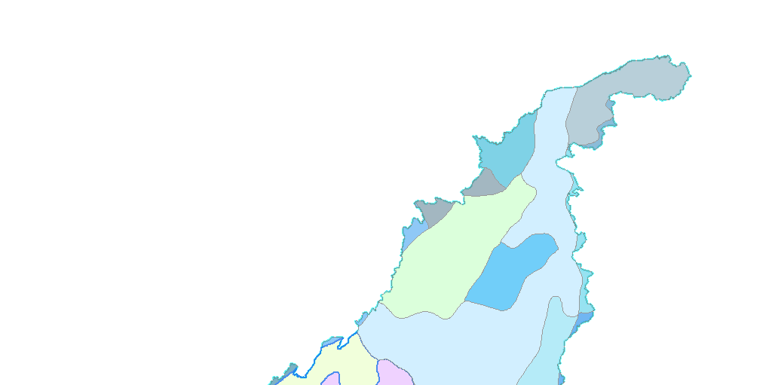
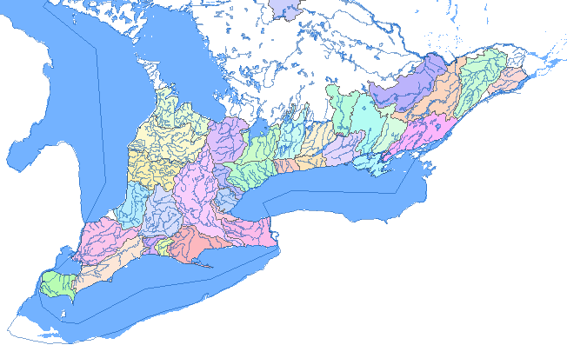
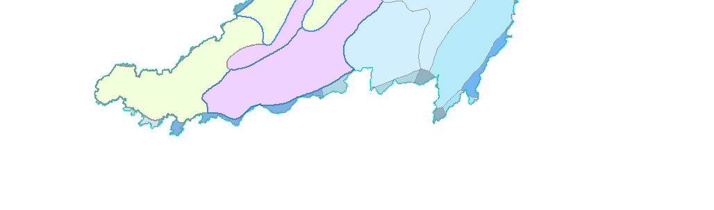
The Southern Ontario
The Southern Ontario
The
Rideau
Valley Watershed and the
Rideau Valley
Ottawa R.
Location of the Mini
-
Piezometers
Georgian
Ottawa R.
and seepage
metres
Georgian
Bay
Lake Huron
Bay
St. Lawrence R
Lake Huron
St. Lawrence R
Location of the study areas
.
Rideau
N
Lake Ontario
Modie
Drive
Lake Ontario
Modie
Drive
Lower
Lower Rideau
Location of the mini-piezometers and seepage metres
(
Mud Cr.
!
(
Mud Cr.
!
!
(
Lake Erie
Jock R.
!
!
.
.
.
.
(
Jock R.
!
(
Lake Erie
!
StevensCr
(
StevensCr
Km
!
0
25
50
100
150
Km
0
50
100
200
200
200
(
.
!
(
!
.
Richmond Fen.
(
!
Kings Creek
Richmond Fen.
Kings Creek
!
(
!
(
(
!
!
(
(
!
!
(
!
!
!
Tay
Cr.
Kemptville Cr
Lower
Rideau
Lower Tay
(
Kemptville
!
Middle Rideau
(
Middle
!
(
!
!
(
(
!
(
!
!
!
Rideau
Upper
Uppe Rideaur
Legend
Upper
Tay
Legend
Upper Tay
!
Seepagemetres
Mini-piezometers
(
Seepage-meters
!
Mini-piezometers
Km
0
4
8
16
24
32
Km
4
8
16
24
32

Slide 4
The three main routes of a water flow and positive/negative seepages

Slide 5
The Jock River flow measurements and the undetected negative flow
Spatial variability in geology, topography, landuse, vegetation

Slide 6
An assemblage of a seepage meter used for measuring positive and negative seepage flux

Slide 7
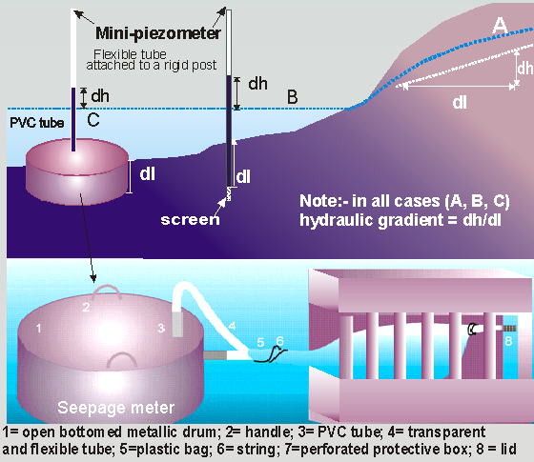
Hydraulic gradients and different types of mini - piezometers and a seepage-meters

Slide 8
An assemblage of a seepage meter used in deep water

Slide 9
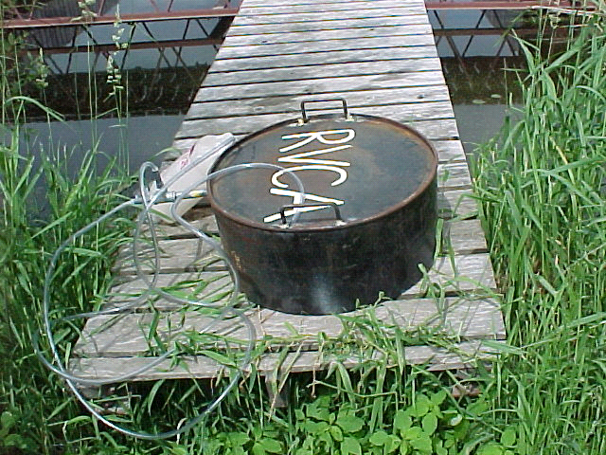
An assemblage of a seepage meter used for measuring positive seepage flux
A plastic bag is attached to the end of the
tube and kept inside a heavy metal container
to prevent it from floating (see previous slides)

Slide 10
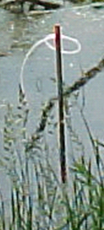
Initial measurements during installation of the mini-piezometers
Location
Location Name
Eastings
Northings
Date
Original Mark
Surface water
Sediment
dL
on 1:50,000
Instrumented
From Water level
Original
Original
Sed.depth
Topo Maps
level (cm)
Depth (cm)
depth (cm)
minus 6.5 cm
G4
-
2411
Upper Steven Creek on Roger Stevens Dr
437731
4993265
8
-
Jun
-
99
50
39
33.5
27.0
Measured
groundwater
Level (+ or -) with reference to surface water level
G4
-
2509
Richmond Fen along Roger Stevens Dr
435991
4991791
8
-
Jun
-
99
40
40
107
100.5
G4
-
2708
Richmond Fen along Roger Stevens Dr
434194
4990144
8
-
Jun
-
99
50
40
96
89.5
G4
-
2907
Richmond Fen along Roger Stevens Dr
432847
4989321
8
-
Jun
-
99
30
30
36
29.5
G4
-
3119
Richmond Fen along Franktown Dr
430926
5002131
15
-
Jun
-
99
50
25
40
33.5
G4
-
2722
Richmond Conservation Area
434903
5004679
15
-
Jun
-
99
50
32
91.7
85.2
G4
-
2526
Jock River at Richmond Road
436557
5009028
8
-
Jun
-
99
50
40
60
53.5
G4
-
3514
Kings Creek
426434
4996525
15
-
Jun
-
99
50
15
30
23.5
G4
-
1306
Kemptville Creek
448603
4988371
10
-
Jun
-
99
50
27
73
66.5
G4
-
1605
Rideau R. at Malakoff
445268
4987750
15
-
Jun
-
99
50
50
60
53.5
G4
-
1807
Upper Cranberry Creek @Malakoff
443480
4989823
10
-
Jun
-
99
50
2
70
63.5
G4
-
1414
Lower Cranberry Creek
447522
4996457
10
-
Jun
Initial
mark
-
99
50
44
48
41.5
G4
-
1518
Lower Steven Creek
446518
5000649
10
-
Jun
-
99
50
20
35
28.5
G4
-
2020
Upper Mud Creek
441935
5002839
10
-
Jun
-
99
50
38
84
77.5
G4
-
1724
Middle Mud Creek, 1st line century
444722
5006404
15
-
Jun
-
99
50
30
40
33.5
G4
-
1725
Lower Mud Creek Bankfield
445037
5008138
15
-
Jun
-
99
50
20
70
73.5
C16
-
2515
Near John Miller's House
396821
4970019
15
-
Jun
Measured
Surface water
Level with reference to the 50 cm initial mark
-
99
50
34
57
50.5
C16
-
3308
Tay at Christie Lake
388663
4963991
15
-
Jun
-
99
50
54
27
20.5
C16
-
2810
Tay (middle) s. of DeWitts
393136
4965502
15
-
Jun
-
99
50
45
65
58.5
Initial Surface water level
C16
48
24
17.5
-
2412
Grants Creek
397138
4968196
15
-
Jun
-
99
50
C16
-
2317
East of Glen Tay
398604
4972119
15
-
Jun
-
99
50
35
62
55.5
C16
-
2308
Port Elmsley
411643
4971443
8
-
Jun
-
99
50
65
44
37.5
Where seepage meters were installed

Slide 11
Groundwater level measurements from the mini piezometers, water levels of
the adjacent water bodies and the respective hydraulic gradients calculated
Green shaded columns indicate where hydraulic gradients are negative, or surface water enters groundwater, or seepage is negative

Slide 12
Seepage readings (ml) and the calculated seepage rates - 1999

Slide 13
Location
Number of Events
Average Vertical
Ratio Between
Probability of
Number
Name
Positive
Negative
Gradients
Positive/ Negative
Recharge/Discharge
G4-2722
Jock River at Richmond Conservation Area
15
24
0.0116
-0.0062
0.63
Discharge
G4-2526
Jock River at Richmond Road
11
5
0.0091
-0.0236
2.20
Recharge
G4-3514
Kings Creek
25
1
0.0795
-0.0170
25.00
Recharge
G4-1306
Kemptville Creek
38
0
0.0133
NA
ND
Recharge
G4-1605
Rideau R. at Malakoff
32
2
0.0078
-0.0112
16.00
Recharge
G4-1807
Upper Cranberry Creekat Malakoff Road
4
9
0.0445
-0.0525
0.44
Discharge
G4-1414
Lower Cranberry Creek
14
5
0.0687
-0.1003
2.80
Recharge
G4-1518
Lower Steven Creek
39
4
0.0363
-0.0561
9.75
Recharge
G4-2020
Upper Mud Creek
15
2
0.0420
-0.0613
7.50
Recharge
G4-1724
Middle Mud Creek, 1st line century
1
9
0.0037
-0.2137
0.11
Discharge
G4-1725
Lower Mud Creek Bankfield
11
0
0.0654
NA
ND
Recharge
G4-2411
Upper Steven Creek on Roger Stevens Dr
13
2
0.0393
-0.0296
6.50
Recharge
G4-2509
Richmond Fen along Roger Stevens Dr
15
0
0.0156
0.0000
ND
Recharge
G4-2708
Richmond Fen along Roger Stevens Dr
14
1
0.0057
-0.0045
14.00
Recharge
G4-2907
Richmond Fen along Roger Stevens Dr (west)
13
2
0.0076
-0.0073
6.50
Recharge

Slide 14
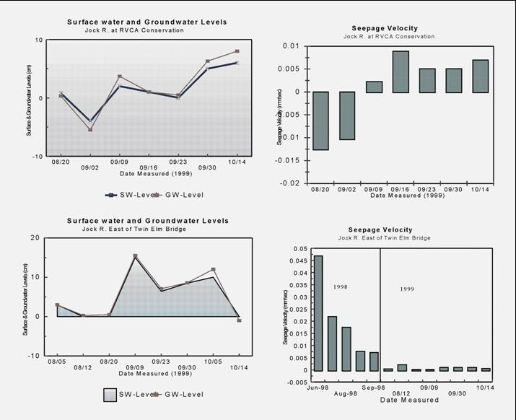
An example of low positive and negative seepages along the Jock River
Surface water level
Groundwater level

Slide 15
Summary of the integrated factors affecting seepage rates
To fill
the
gap

Slide 16
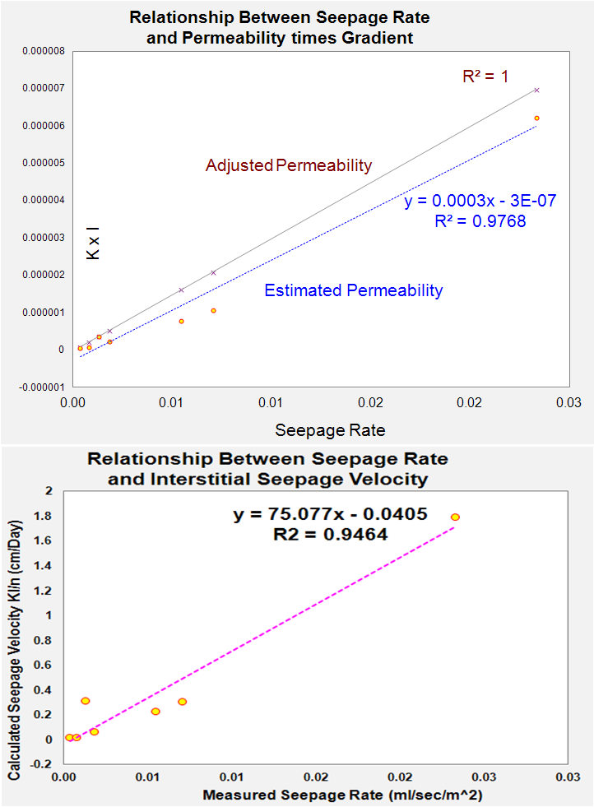
Estimating seepage rates from permeability (literature) and measured gradient, for areas where seepage rates were not measured
(ml/sec/m^2)
Gap filled

Slide 17
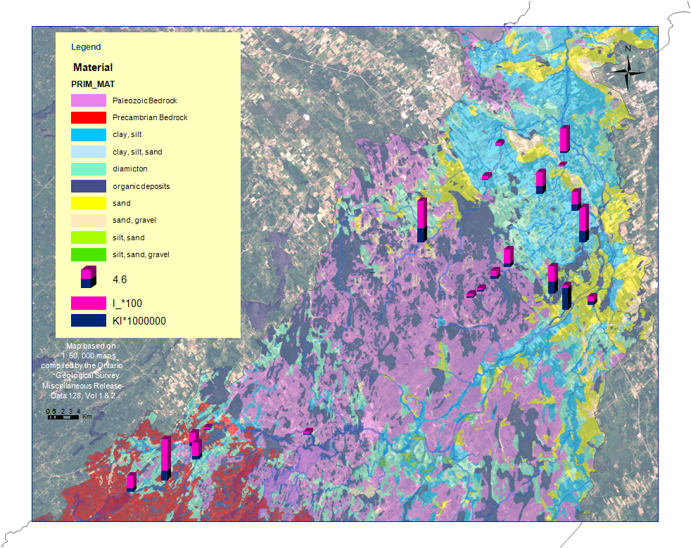
The overall watershed characteristics, and results from the groundwater/surface water interactions
The Jock R
Low gradient
A
Kings Creek
High gradient
B
Wetlands
Both recharg and discharge takes place
Malacoff
Intermittent stream sand and gravel
Rideau and Keptville effect of flood
Tay River
high gradient

Slide 18
Surficial geology along the Kings Creek and the Jock R.
N
The Jock R.
Flat, topography Clay/silt
Kings Creek
Rugged, topography Paleozoic rocks

Slide 19
The Permeability of the Overburden Along the Kings Creek and the Jock R.
Legend
N
High
Low
Low-Medium
Medium
Medium-High
The Jock R.
Variable
Low permeability
Kings Creek
Medium to high permeability

Slide 20
The Groundwater/Surface water interactions Along the Kings Creek and the Jock R.
N
Legend
The Jock R.
27
POSITIVE
NEGATIVE
GRADIENTS
1
Kings Creek
V ( cm/Day)
Seepage
rates
Size of the circle is proportional to the magnitude of the hydraulic gradients

Slide 21
The Surficial Geology Along the Middle Rideau (Malacoff at Upper Cranberry R., the Rideau R, the Lower Cranberry R, and the lower parts of the Stevens and Kemptville Creeks)
z
N
Malacoff
Rideau R.
In general, this area has flat or gently sloping topography towards the Rideau River

Slide 22
The Permeability of the Overburden Along the Middle Rideau River
N
Malacoff
Rideau R.
Permeability is high

Slide 23
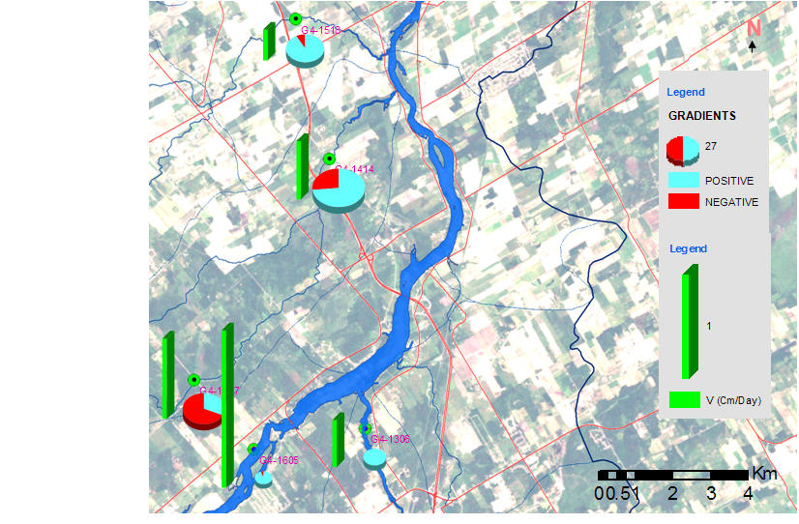
The Groundwater/Surface water Interactions Along the Middle Rideau River
Malacoff
small
intermittent
stream
Malacoff
High seepage due to high permeabilty
higher proportion of negative seepage
Rideau R.
Very high seepage rate at the Rideau, in spite of very low gradient –
This is because of the relatively higher proportion of positive seepage
Rideau River
large river

Slide 24
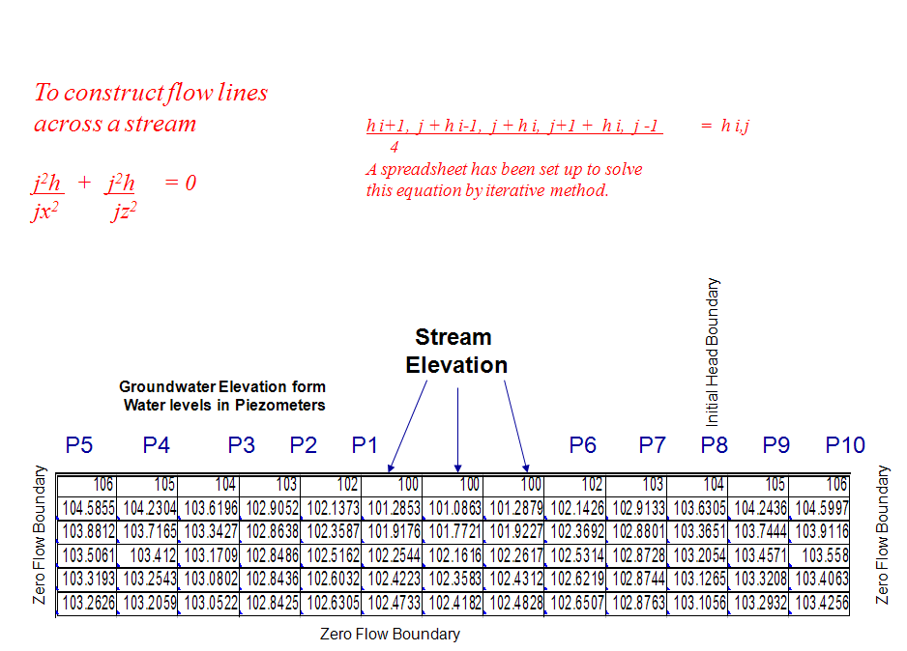
Simulation of flow across a stream - the effect of flood

Slide 25
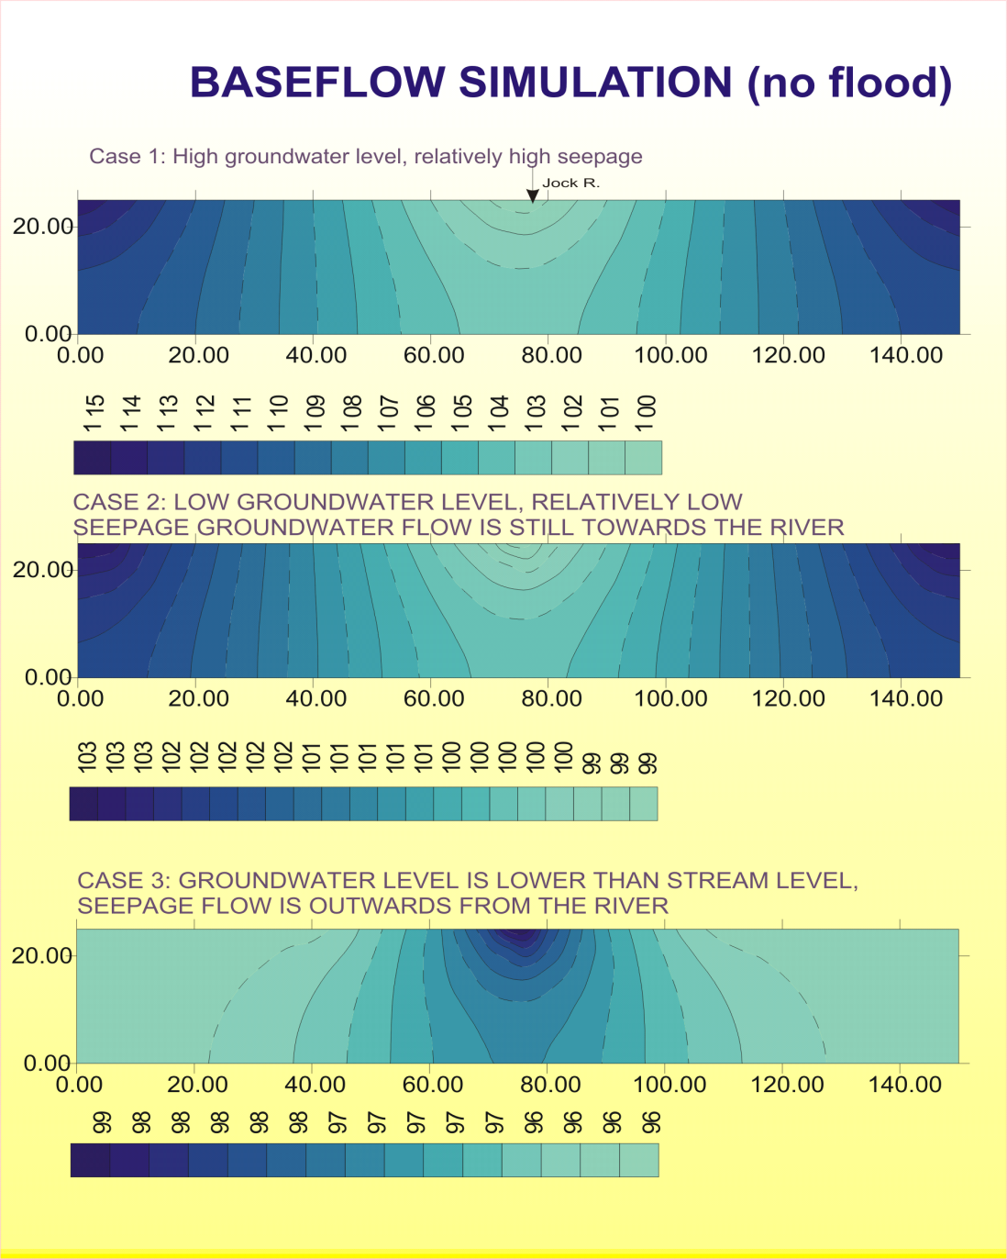
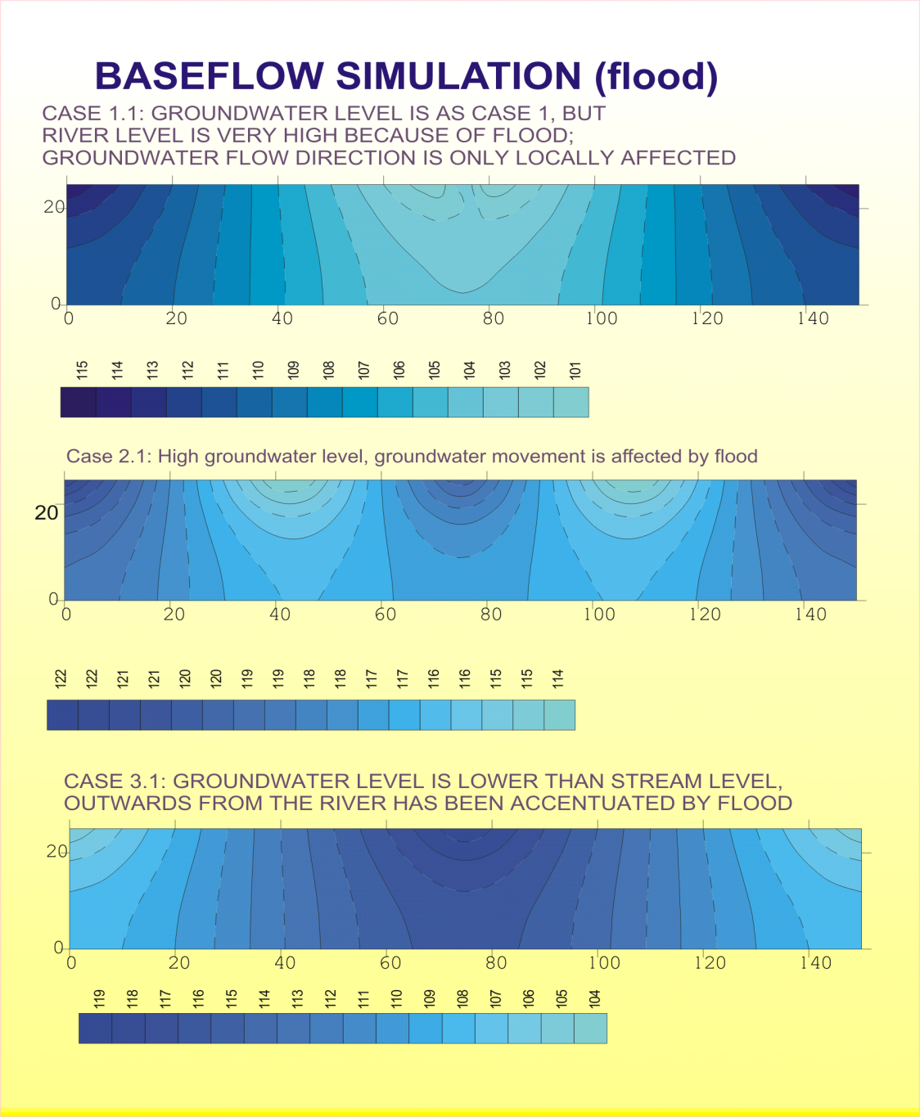
Result of Simulation -
The effect of flood on groundwater/surface water interactions – different scenarios

Slide 26
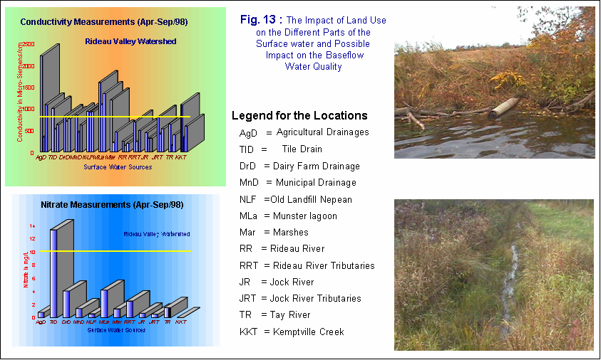
Surface and near surface water quality variations
The Impact of Land Use on the Different Parts of the Surface water and Possible Impact on the Baseflow/Groundwater Water Quality

Slide 27
Conclusions
  The major factors affecting near surface recharge/discharge conditions, hence negative/positive seepage rates are hydraulic gradient and permeability
  These two factors varied significantly along streams and from one sub- watershed to another, due to mostly variations in geology and topography
  Also significant temporal climatic variations were observed to have significant impact on the surface water and near surface groundwater
  Determining seepage water quantity was helpful in understanding better the overall sub-watershed characteristics
  A better management of all water resources can be achieved by studying the connectivity between the surface water, the shallow and the deep Groundwater, which may include seepage quantity/quality and the effect of flood

Slide 28
The end
Thank You

